Slide 1

Sterilization
Our topic this time is "sterilization", which is you already know in our last CE presentation, and now we focus on community work; the user is set as the staff of the neighborhood committee, the ladies.

Slide 2
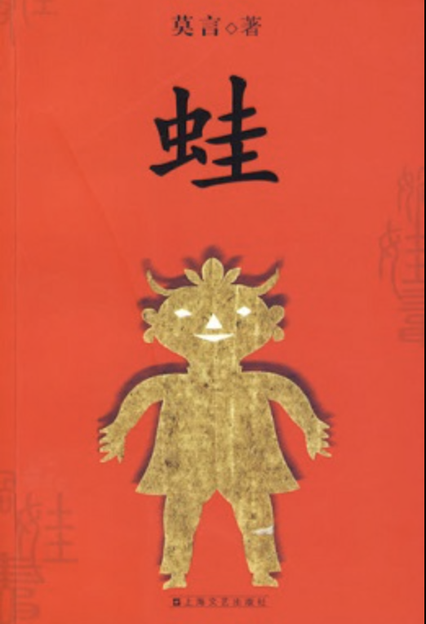
Frog (novel)
China's national situation is really subtle. In the past, the government emphasized the family planning policy in one particular way as stated in one of the Nobel Prize winner Mo Yan's "Frog". The book is a very graphic description of this policy which is overused in the countryside, resulting in some abnormal phenomena. But due to the labor shortage, on January 1, 2016 , the government officially announced the two-child policy; and later on May 31, 2021, came the third-child policy. Yet, the reality is that, especially in cities like Shanghai, people are not willing to have children at all.

Slide 3
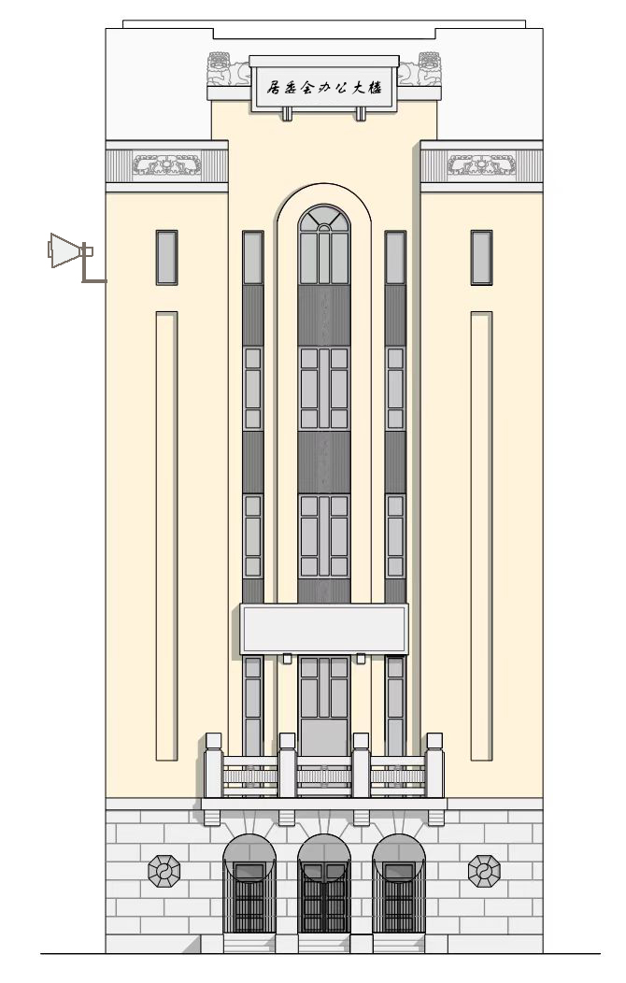
Neighbourhood Committee Building
Popularize one fetus, control two, eliminate three
Birth and death, good pregnancy and good fortune.
Nothing is more beautiful than a woman who is nursing.
So we try to provide a service for the neighborhood committee ladies that can facilitate their work by keeping a log and enhancing their memory of the different policy slogans. This will allow us to gain insight into the feedback from the community on the policy so that we can delve deeper into the research on this topic.

